Slide 1
XAI Algorithms
Group Dynamic

Slide 2
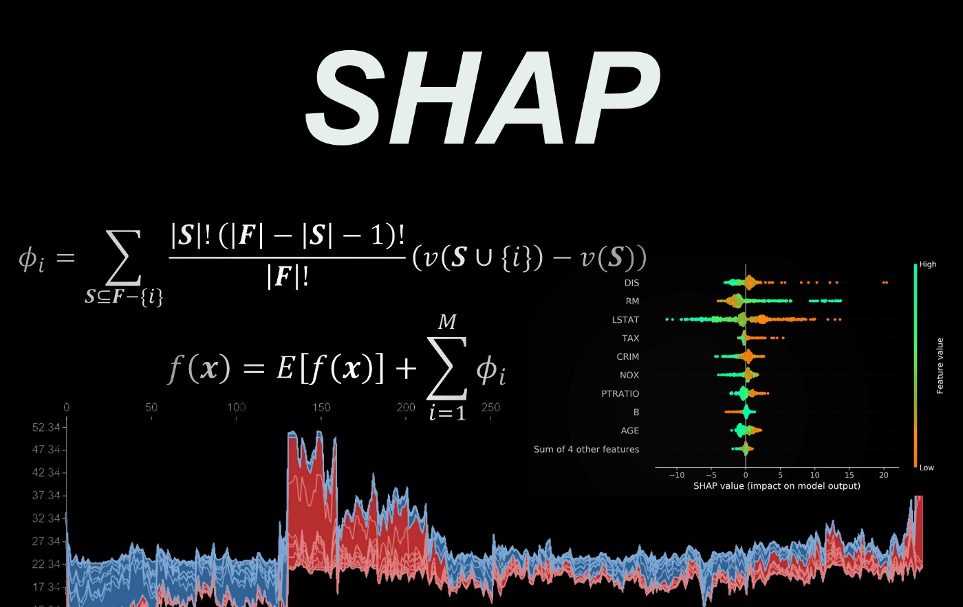
SHAP (Shapley Additive Explanations)
SHAP (Shapley Additive Explanations) is a game theoretic approach to explain the output of any machine learning model. It connects optimal credit allocation with local explanations using the classic Shapley values from game theory and their related extensions.
Shapley values are a widely used approach from cooperative game theory that come with desirable properties. The feature values of a data instance act as players in a coalition. The Shapley value is the average marginal contribution of a feature value across all possible coalitions. It can determine the most important features and their influence on the model prediction.

Slide 3
LIME (Local Interpretable Model-agnostic Explanations)
LIME is created to introduce a concrete implementation of local surrogate models that are interpretable models which are used to explain individual predictions.
LIME method explains the model by locally approximating it around a given prediction and making interpretations about individual model predictions based on these.
The main logic of the algorithm is as follows: Since there is a model that takes an input and makes predictions, you have to find the working of this model. To do so, this method creates variations of input and get the corresponding predictions. Then, it appends all of these into a new dataset and trains an interpretable model on it. This interpretable model is weighted by the proximity of the sampled instances to the instance of interest. Lastly, the explanation is done by interpretation of the local model.

Slide 4
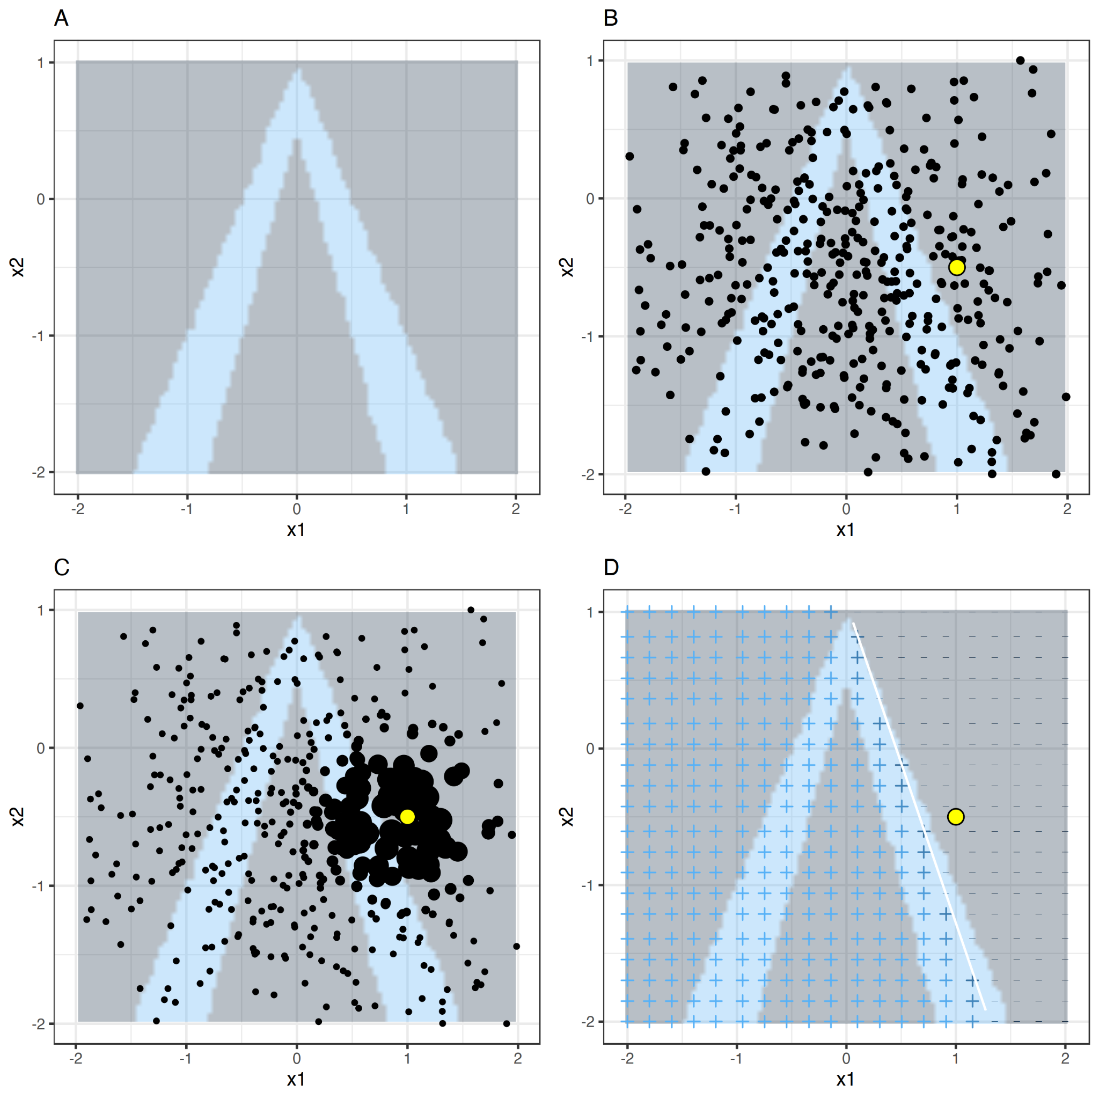
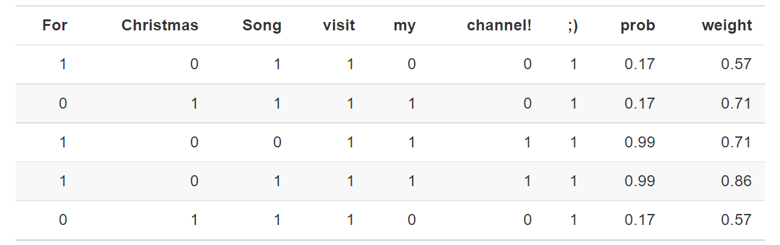
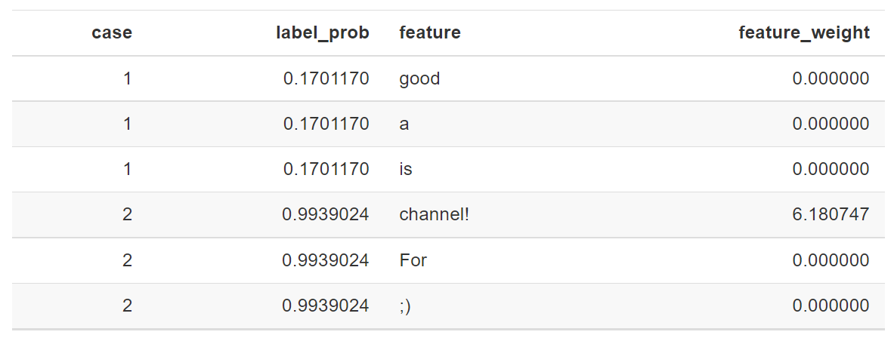
LIME (Local Interpretable Model-agnostic Explanations)
LIME method varies for different data types.
Tabular data: Predictions (A), instance of interest and sample data (B), assigning higher weights to neighbourhood of instance of interest (C), locally learned model from the weighted samples(D).
Text: In a sentiment analysis example, the comment “For Christmas Song visit my channel! :)” is a spam. Firstly, variations are created by adding and deleting words in this comment (1). Then, weight is decided based on this (2).
Images: Superpixels, interconnected pixels with similar colors, are used instead of changing individual pixels to create sample data.

Slide 5
Explainer Dashboard
Explainer Dashboard is an extensive and engaging interactive dashboard library to explain ML models across various spectrums and methodologies.
This dashboard covers various aspects of ML explainability such as :
Metrics and evaluation
Local prediction explainability
What if analysis
Decision trees
Feature dependencies
Interactions
Future importance

Slide 6

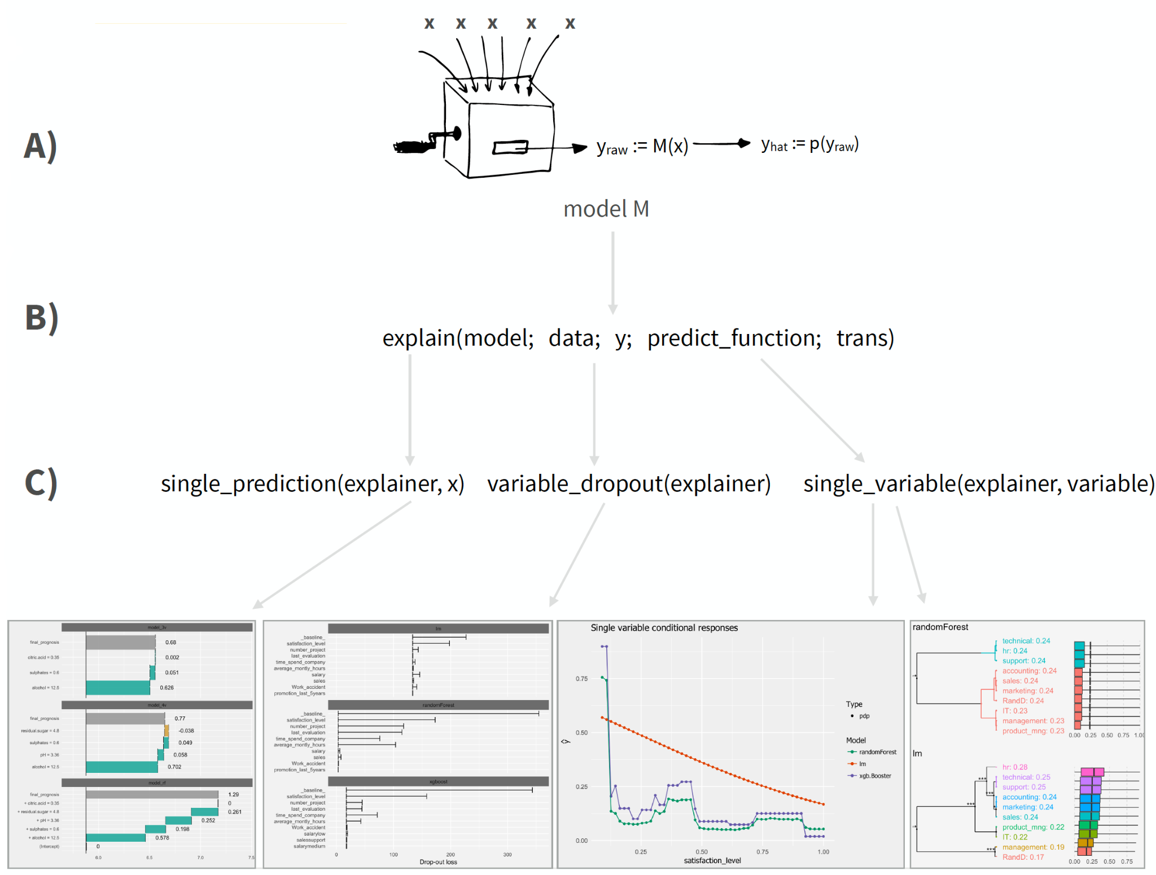
Dalex (Descriptive mAchine Learning EXplanations)
The DALEX method can help us better comprehend the models we are working with. Some of the models utilized in the preceding section were somewhat complicated. To truly understand what is going on behind the models, accuracy and ROC are insufficient. As a result, selecting a model is challenging. This strategy will provide us with new information about the database as well as the significance and behavior of specific variables.
Some advantages of Dalex method:
It can be used for any supervised regression and binary classification ML model where you can customize the format of the predicted output.
Provides convenient approaches to compare results across multiple models.
Uses a permutation-based approach for variable importance, which is model agnostic, and accepts any loss function to assess importance.
Leverages the pdp package.
Includes a unique and intuitive approach for local interpretation.

Slide 7
 | Pros | Cons | Performance
SHAP | -Great for summary and dependence plots. -The SHAP values can show how much each predictor contributes, either positively or negatively, to the target variable. -Each observation gets its own set of SHAP values. -Only method that can fairly distribute the gain of the feature. | -Doesn't seem intuitive enough. -SHAP doesn’t return a model so, if you want to simulate scenarios of increase in a particular feature will impact the output by how much, then it’s not possible with SHAP. | Number of possible combinations of the features exponentially increases as more number of features are added. This in turn increases the turn around time of calculating SHAP values.
LIME | - Same LIME method can be used when the main model changed as it is based on local surrogate models. - Interpretable model used within can be changed according to the requirements such as short or detailed explanations. - Works for tabular data, text, and images. - Reliability of interpretable model can be seen by fidelity measure. - Model can use external interpretable features that are not used in the original model. | - It is based on the identification of the neighbourhood of the instance of interest in tabular data. Yet, the identification is a problem to be solved. - Sampling is solely based on Gaussian distribution. - Low reliability due to the instability of the explanations. - Manipulations are possible to hide biases. - As it uses locals, it is effective locally but not globally. | Not costly for few observations but costly for global interpretations.
Explainer Dashboard | -More detailed -Interactive -User-friendly | Dashboard can get a bit overwhelming with the various components. | Can work with efficiently scikit-learn, xgboost, catboost, lightgbm, and skorch (sklearn wrapper for tabular PyTorch models) and others.
Dalex | Allows to compare residual distributions and provides an alternative to PDPs for categorical predictor variables. | Currently, only supports regression and binary classification problems, does not provide ICE curves and alternative local interpretation algorithms such as LIME and SHAP. | - Can work efficiently with a lot of tools such as scikit-learn, keras, H2O, tidymodels, xgboost, mlr - Can be slow and costly.

Slide 8
Resources
Lundberg, Scott & Lee, Su-In. (2017). A Unified Approach to Interpreting Model Predictions.
https://shap.readthedocs.io
https://towardsdatascience.com/introduction-to-shap-values-and-their-application-in-machine-learning-8003718e6827
https://christophm.github.io/interpretable-ml-book/lime.html
Dieber, Jürgen & Kirrane, Sabrina. (2020). Why model why? Assessing the strengths and limitations of LIME.

